Slide 1
Blockchain Based Online Market System
Presented by
Sajil Lidhan T
Reg No: SNG20MCA-2037

Slide 2
Thanks to
Prof. Jiss Kuruvila (My Project Guide)
Prof. Sandhya (Our HOD)
.

Slide 3
Contents
Introduction
Abstract
Existing System
Proposed System and It’s Objectives
Modules and Description
Feasibility Study
Software and Hardware Requirments
Database Design
Usecase and Activity Diagram
Snapshots

Slide 4
Introduction
Blockchain based online market system that provides secure payment through online transaction.
The biggest problem we face in online payment system is the security threats and vulnerabilities.
The current system contains security problems that lead into several theft and online fraud system.
To overcome these problems we are creating this system called blockchain based online market system

Slide 5
Abstract
This website allows customers to connect to the seller directly
This website provides solution to private payment to ensure privacy of the users
It allows the trade to be open, transparent with immutable transactions

Slide 6
Existing System
The existing system provides online payment which can lead into online payment theft and fraud activities.
Current system share personal information of users.
For payment system there will be a middle system which cost service charges for transaction

Slide 7
Proposed System
This website allows customers to connect to the seller directly
This website provides solution to private payment to ensure privacy of the users
It allows the trade to be open, transparent with immutable transactions

Slide 8
Modules and Description
Admin
Login
View Seller
View Products
View Users
View Bookings
Seller
Register
Login
Manage Products
Wallet Generation
View Bookings
View Payment
Update status to delivered
User
Register
Login
Wallet Generation
View Products
Book Products
View Orders
Make Payment
View Status

Slide 9
Feasibility Study
Feasibility study is defined as the practical extend to which a project can be performed successfully
Types of feasibility study
Economic Feasibility
Operational Feasibility
Technical Feasibility

Slide 10
Economic Feasibility
Economical feasibility is the most frequently used method for evaluating the effectiveness of a system
it is most commonly known as cost benefit analysis.
The procedure to determine the benefits and savings that are expected from a system and compare them with cost
Under the economic feasibility we have done a cost benefit analysis by conducting the economic feasibility
Python and SQL databases are easily available on internet . so the project is economically possible
it was clear the benefits out weights cost and then the decision is made to continue the project

Slide 11
Operational Feasibility
The project has been developed in such a way that it becomes very easy even for a person with little computer knowledge to operate it.
This application is very user friendly and does not require any technical person to operate.
Thus the project is operationally possible
The proposed project is beneficial, because it can be turned into an information system that will work when its developed and installed.
There are no barriers to implementation.
The proposed system is a sophisticated system, hence it covers all the over frequently needed facilities.

Slide 12
Technical Feasibility
It deals with the hardware and software used in the system
This system use windows platform ,MySQL for database ,python.
Thus the project is technically possible.
Technical feasibility concentrate on the existing computer system and what tends it can support the proposed system.
Technical feasibility is highly computer oriented process.
sing a computerized system , time and effort is reduced to a great extent.

Slide 13
Software and Hardware Requirements
Minimum Software Requirements
Operating system : Windows 7 or above
Front end :html,css
Language :Python
Backend :MySQL
Framework :Flask
IDE :Sublime Text Editor
Minimum Hardware Requirements
Processor :intel core i3 or above
RAM :4GB
Hard Disk :20GB

Slide 14
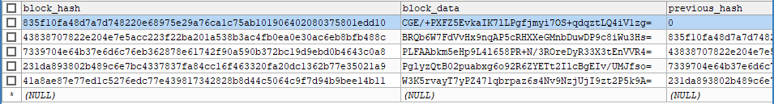
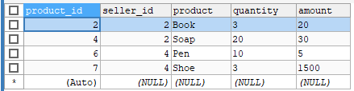
Database Design

Slide 15
Activity Diagram
Seller
Admin
Customer
Login
View Products
Manage Order & Delivery
Manage Account
View Customer
Manage Payment
Manage Purchase
View Seller
Manage Products
Manage Payment

Slide 16
Use Case Diagram
Blockchain based online
market system
Admin
View cart
View Seller
View Customer
Manage Account
Customer
Blockchain System
Manage Purchase
Make Payment
Seller
Manage Order and Delivery
Manage Products

Slide 17
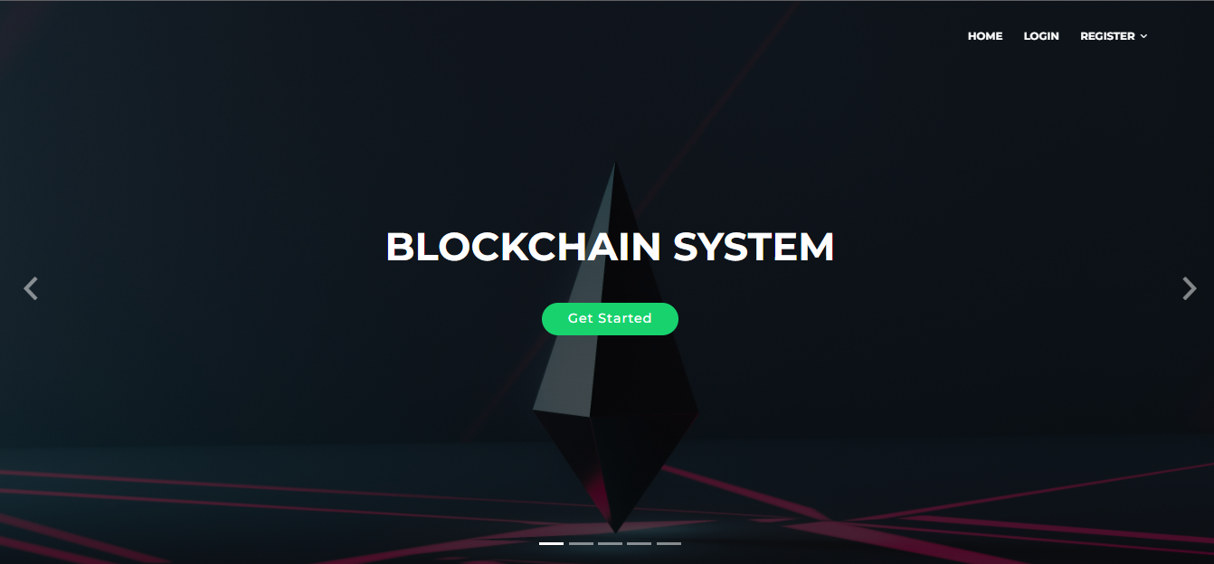
Snapshots

Slide 18
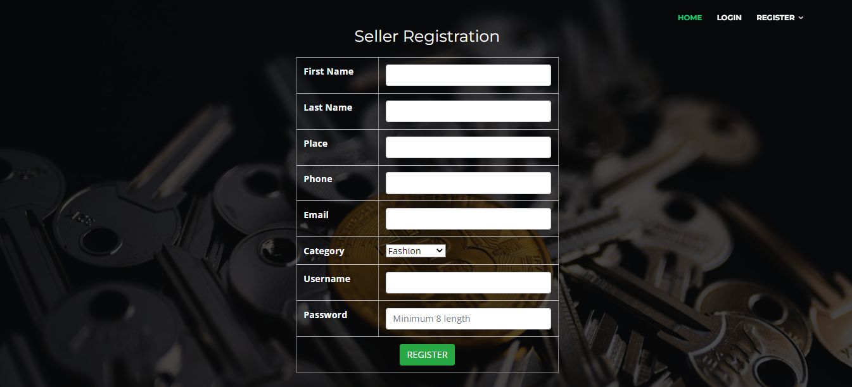

Slide 19
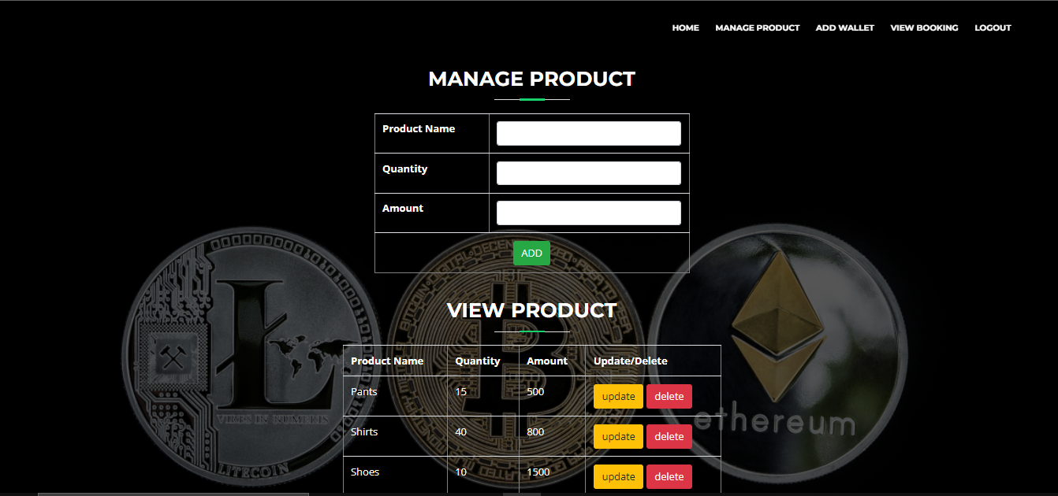

Slide 20
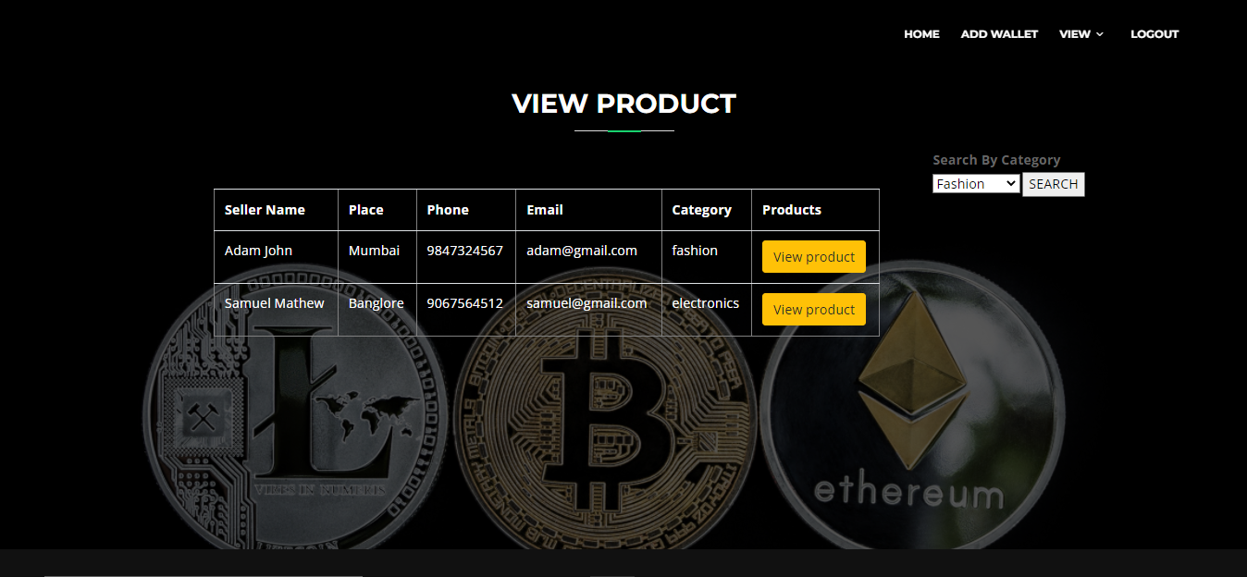

Slide 21
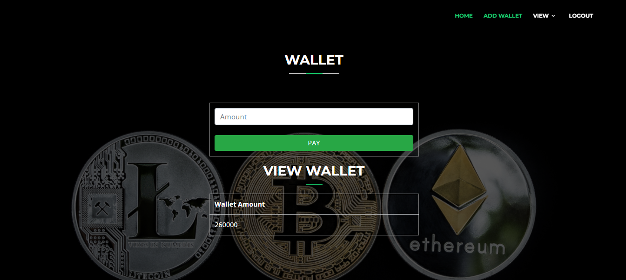

Slide 22
Thanks!

